Slide 1

Eelo University Faculty of Computer Science and Business Technologies Course: Web Designing
Instructor: Abdurrahman Ahmed
Web Administrator, EU

Slide 2
Chapter Two
Structuring and formatting HTML Elements

Slide 3
HTML formatting elements
The h1 to h6 Elements
The <h1> to <h6> elements are used for document headings. A heading can be a title for a page, paragraph, chapter, etc. The <h1> element define the main heading(s) of the document. The <h2> element defines a heading smaller than <h1> etc. The <h6> element can be used as the least important heading.
Heading elements are typically displayed in a larger font than the rest of the text in the HTML document.

Slide 4
Cont..
Headings help define the structure of the page and control the hierarchy of the content.
While there are several competing theories on the exact strategy to use when choosing headings, what really matters is that you are using them in an intelligent manner.

Slide 5
Cont..
The p Element
The <p> element marks a paragraph of text in the HTML document. A paragraph contains multiple sentences that are related to each other. Two paragraphs following each other will be displayed with space in between to mark the different paragraphs.
The paragraph tag is one of the most basic formatting tags, and one that you'll use often. It indicates a paragraph of text, and should be used for each individual paragraph.

Slide 6
cont..
The br Element
The <br> element can be used to force an automatic single line break e.g. in between two paragraphs, or after a line within a paragraph.
The <br> element do not need an end tag, because it is an empty element.
let us Code

Slide 7
Cont..
The b Element
The <b> element marks text to be displayed as bold.
The i Element
The <i> elements marks text to be displayed as italic.
The strong Element
The <strong> element is used to mark text to be displayed strong. In practice the effect is similar to the <b> element, although browsers may differentiate between the effect of the two elements.

Slide 8
Cont..
The em Element
The <em> element marks text to be displayed as emphasized.
In practice the effect is similar to that of the <i> element, although browsers may differentiate between the effect of the two elements.

Slide 9
Cont..
The code Element
The <code> element is used to markup blocks of text to be displayed using a mono size font, like Courier.
The <code> element is typically used to display programming code.

Slide 10
Cont..
The del Element
The <del> element marks text as deleted, meaning it will be displayed with a line through it.
Underlined Text
Anything that appears within <u>...</u> element, is displayed with underline.
Let us Code

Slide 11
Content Structuring
In this chapter so far we have covered the formatting elements.
In this next section we will explore how to structure the page probably by examining the sectioning elements available in HTML.
Using these elements gives more semantic meaning to your pages, allowing computer programs to better understand your content.

Slide 12
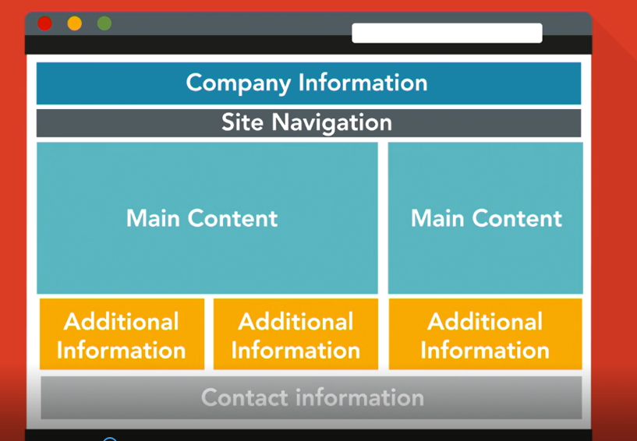
Content structuring

Slide 13
Semantic Elements in HTML
A semantic element clearly describes its meaning to both the browser and the developer.
Examples of non-semantic elements:<div>and <span> tells nothing about it is content.
Examples of semantic elements: <form>, <table> and <article>

Slide 14
HTML Block and Inline Elements
Every HTML element has a default display value, depending on what type of element it is.
There are two display values:
Block and
inline.

Slide 15
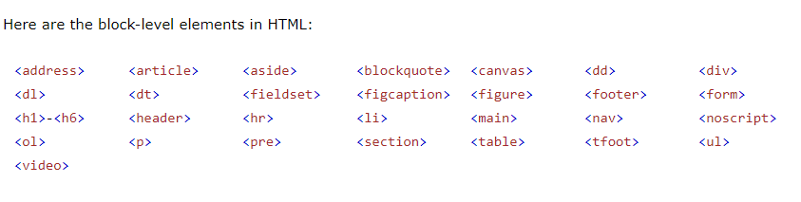
Block-level Elements
A block-level element always starts on a new line and takes up the full width available (stretches out to the left and right as far as it can).

Slide 16
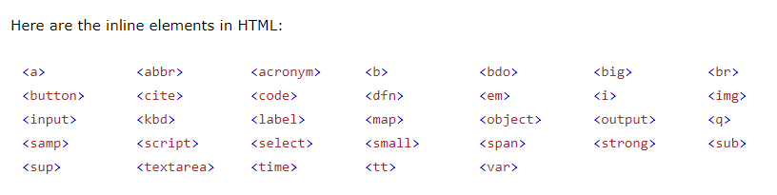
Inline Elements
An inline element does not start on a new line and it only takes up as much width as necessary.

Slide 17
Semantic Elements in HTML5
In HTML there are some semantic elements that can be used to define different parts of a web page
Example of these semantic elements are
<article>
<main>
<header>
<footer>
<section>
And more others

Slide 18
The nav Element
The <nav> element is used to markup a collection of links to external pages or sections with current page.
It also used for the main website navigation.
The <nav> element is also a good fit for things like a table of contents.
Let us code

Slide 19
The article Element
The article element should contain a piece of self-contained that could be distributed outside the context of the page.
This includes things like news articles, blog posts, or user comments.
The article element represents a complete or self- contained, composition in a document, page, application, in principle independent distributable or reusable .
Let us code

Slide 20
Section Element
The section element is used to represent a group of related content.
This is similar to the purpose of an article with the main difference is the content within <section> element doesn’t necessarily need to make sense out of the context of the page.
It is advisable to use a heading element (<h1>-<h6>) to define the topic for the section.
Let us code

Slide 21
The aside Element
The aside element is used to represent content that is tangibly related to the content that surrounding it, but could be considered separate.
This include things like sidebars.
Let us code

Slide 22
The header Element
The <header> element is used to represent the introductory content to an article or web page.
A <header> element will be associated with the nearest sectioning element, usually it is parent in the page structure.
Let us code

Slide 23
The footer element
The <footer> element is used to represent information about a section such as the author, copyright information.
Contact information for the author or editor of the section belongs in an address element, possibly its self inside the footer.
Let us code

Slide 24
The address element
The address element represents the contact information for its nearest article or body element.
This element is not for marking up postal address but rather then representing the contact information for an article or web page.
The <address> element must not contain information other contact information.
Let us code

Slide 25
The main element
The main element should contain the main content for your web page.
All of this content should be unique to the individual page and should not appear else where on the site.
Any content that is repeated on multiple pages should not be placed with the <main >element.
Let us code

Slide 26
The <div> Element
The <div> element has no special meaning at all. Instead, it's used to group content so it can be easily styled.
Authors are strongly encouraged to view the <div> element as an element of last resort, for one no other element is suitable.

Slide 27

END OF CHAPTER 2

